Slide 1
Increasing Grantee and Subrecipient Capacity: Opportunities and Challenges
Elizabeth McNannay

Slide 2
Background
The City of Caldwell is a small CDBG entitlement grantee = $498,085 for program year 2021
CDBG CV1 = $292,484
CDBG CV3 = $210,072
Population approx. 55,000
Over 50% of population is LMI

Slide 4
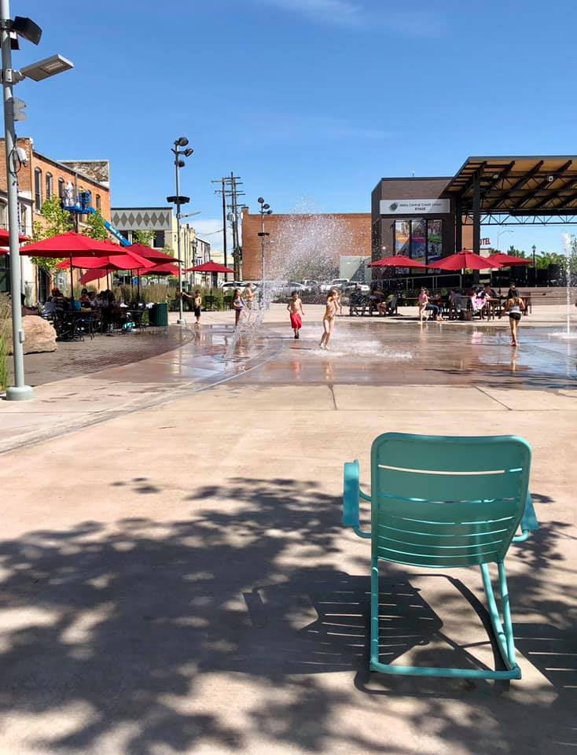
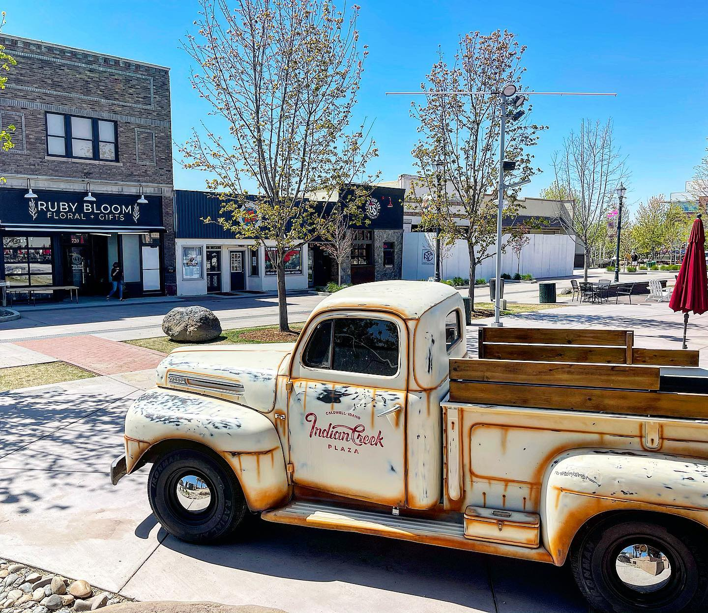

Slide 5
Where did we start?
INTERNAL CAPACITY
Well…
Where are we now?
Well…

Slide 6
What’s a good plan?
Subrecipient application
Risk analysis
Subrecipient agreement
File checklist
Monitoring and oversight
Resources
More thoughts. . .
Notes:
Focus: 80-90% of the time, energy, and focus on technical assistance and setting expectations happens before a subrecipient starts any work.
The responsibility for program success lies with the entitlement community.
A strong framework helps increase the capacity at the entitlement and the subrecipient.
Everyone benefits from
Clear expectations
Clear goals
Resources to solve problems
Using resources (time, money, capacity) wisely and thoughtfully
An environment where learning and making mistakes results in better processes and increased trust (for both city staff and subrecipients)

Slide 7
Subrecipient Application
Organization for administrative Systems and financial management systems
Timeline and deliverable
Project objectives
Statement of work
Notes:
So, how do you get the tools in place to monitor program success quarterly and ensure that the subrecipient is even a good fit for receiving the federal funding?
Focus on a complete subrecipient application, even if it is non-competitive that outlines:
Federal regulations on the structure of their organization for administrative systems and financial management systems; board, bylaws, policies and procedures, civil rights, financial controls, staff resumes, conflict of interest policy, etc. They should be providing these document during this application process. Monitoring for this compliance after they’ve finished their program year is not the time to evaluate whether they are a good fit for receiving federal funding
Timeline and list of deliverables. This allows for continual monitoring of their program as they turn in their invoices and reports during the year. Invoices and reports go hand in hand together, with no money being paid out for invoices that do not include reports or no outcomes. For almost all subrecipients, invoices and reports should be received quarterly, at a minimum.
Project objectives should include national objective, eligible activity, matrix code, consolidate plan goal, action plan goal, and goal outcome indicators. This set will require technical assistance for many subrecipients, but it lays the ground work for being able to understand the narrow box that their activity must live within. It also makes it easier for the non-profit to research and understand their one area within CPD programs.
A Statement of Work in the application makes setting up projects in the Action Plan and activities in IDIS so much easier. Let the stakeholder describe their work with a needs statement, description of population to receive assistance, description how they will ensure persons assisted qualify under HUD guidelines, physical location, project outline, and outcomes.

Slide 8
Risk Analysis
Beginning of program year, before contract is signed
End of program year to determine
What type of annual monitoring is required
Whether organization can reapply for future funding
Notes:
A risk analysis at the beginning (prior to a signed contract) and at the end of the program year helps to ensure that an entitlement community isn’t putting undue stress on a non-profit and that federal funds meet defined outcomes. The risk analysis should be shared with subrecipients so they know how they are being measures.
A risk analysis is also easy to add to the subrecipient agreement. Let the non-profit tell you in detail what their challenges are and why they are low risk. Then, city staff still has to do their own risk assessment. But, this approach allows for the conversation about internal challenges, staff changes, etc. to happen early in the process.
No surprises.
No non-profit is perfect, and it’s critical to know how and what type of technical assistance they will need.

Slide 9
Scope of Work
Critical component of the subrecipient agreement
Scope of work includes national objective, eligible activity, goal outcome indicator, staffing, monitoring, reporting, closeout, schedule/timeline, detailed budget, primary contact, etc.
Detailed and specific
Tool for monitoring and gauging success
Notes:
The subrecipient agreement needs to have a robust scope of work. The scope of work is developed from the subrecipient application and the discussions/negotiations that occur after review of the agreement. The agreement is just a starting point. It’s up to the entitlement community to set the stage for success and make needed changes in the program activity, timeline, budget, etc.
A strong scope of work is required in order to comply with 2 CFR 200.
This is the legal document that provides for recourse if the subrecipient is not meeting deliverable, compliance, etc.
Scope of work should include elements national objective, eligible activity, goal outcome indicator, staffing, monitoring, reporting, closeout, schedule/timeline, detailed budget, primary contact, etc.

Slide 10
File Checklist
Better organization
Clearer expectations
Monitoring is easier
Better chances of compliance
Notes:
Subrecipients benefit from having a file checklist to help them organize their file systems. This makes for easier monitoring and ensuring compliance with federal regulations. This checklist is nearly identical to the one used by the entitlement community. The information in the subrecipients files and the entitlement community files should mirror each other.
Key items in the checklist cover administrative systems, financial management systems, program operation, client records, monitoring letters, training log, invoices/report to entitlement community.

Slide 11
Monitoring and Oversight
Monitoring and oversight are ongoing activities
Tie invoicing and reporting cycles together
Have a plan and communicate consequences/remediation for not achieving goals/deliverables
Stop paying subrecipient who don’t have deliverables
Annual monitoring
Notes:
The responsibility for program success lies with the entitlement community.
Use tools like the subrecipient application and risk analysis to choose subrecipients that demonstrate they have the capacity to meet federal regulations and meet program objectives. Don’t give money to organizations that aren’t ready. It’s an ineffective and non-compliant way to spend funds and it puts the non-profit into an unreasonably stressful situation. A great project is not enough. . . .
Use the tools of evaluating the invoices and project reports to determine if the subrecipient is one track. If they are not, the option is to stop funding, provide technical assistance and reduce funding, or to increase the timeframe for monitoring an invoicing (more hands on. Move from quarterly to monthly reporting or weekly.)
Remember that annual monitoring is not a choice; it’s a requirement. All activities (even those conducted within the entitlement city) are required to have a desktop monitoring or in-person monitoring. The City is required to show why the subrecipient did not have an in-person monitoring. This is where that annual risk analysis comes in. The risk analysis helps the city determine (1) what type of monitoring should be conducted and (2) if they subrecipient will be eligible to apply for future funding.

Slide 12
Resources
Playing by the Rules
CPD Monitoring Handbook
2 CFR 200
Governing regulations
Applicable CPD notices
HUD Exchange
Communicate changes
Notes:
Subrecipients need the resources to understand the program, answer some of their own questions, and invest in increasing their own internal capacity for working with CPD funded programs
At the beginning of the program year, all subrecipients need to receive a copy of Playing by the Rules
CPD Monitoring Handbook, and outline which exhibits apply to their program
Governing regulations
2 CFR 200
Applicable CPD notices
Information on how to use HUD Exchange, get on HUD email lists, trainings, etc.
Program changes and regulations communicated through CPD offices, CPD notices, HOME fires, or HUD exchange need to be shared with subrecipients immediately.

Slide 13
Best Practices
Standardize regional projects/activities
Use funds strategically and effectively
Listen and integrate information from subrecipients
Make timely and consistent payments on invoices
Notes:
If you your subrecipients are working regionally with multiple entitlement communities, try to standardize program requirements, reporting, cost per hour, etc. as much as possible.
Keep contracts for subrecipients to $25,000 or more. It’s critical for entitlement communities to understand how much it costs in internal resource and oversight for a non-profit to administer a grant of $10,000 and the subsequent federal regulations. It doesn’t lend itself to making substantive and efficient change for vulnerable communities nor does it benefit the non-profit.
Be aware of asking for time and energy from subrecipients. When engaging in public outreach, listening sessions, public comment, asking for applications, make sure that the information is useful and that the city is willing to make potential changes based on the information. (I said this wrong. . . .)
Pay quickly, timely, and consistently

